Slide 1
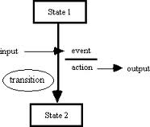
State Transition Testing
Testing Depending on the Transition History
Software Quality Assurance
Telerik Software Academy
http://academy.telerik.com

Slide 2


The Lectors
Nikolay Nedyalkov
QA Architect
XAML Division
email: nikolay.nedyalkov@telerik.com
Petar Horozov
Principal QA Engineer
XAML Team2 email: petar.horozov@telerik.com

Slide 3

Table of Contents
What is state transition testing
Deriving Test Cases
Superstates and Substates
State Transition Tables
Generating Test Cases From State Transition Tables
Switch Coverage
State Testing with Other Techniques

Slide 4

What is State Transition Testing?
Main Concepts of State Transition Testing

Slide 5

What is State Transition Testing?
State transition testing:
A black-box test design technique in which test cases are designed to execute valid and invalid state transitions

Slide 6

When Is State-based Testing Useful?
When can we use State-based testing?
When we have sequences of events that occur and conditions that apply to those events
When the proper handling of a particular event/condition situation depends on the events and conditions that have occurred in the past

Slide 7

The Bug Hypothesis
What is the bug hypothesis in state-based testing?
We're looking for situations where the wrong action or the wrong new state occurs in response to a particular event
Under a given set of conditions based on the history of event/condition combinations so far

Slide 8
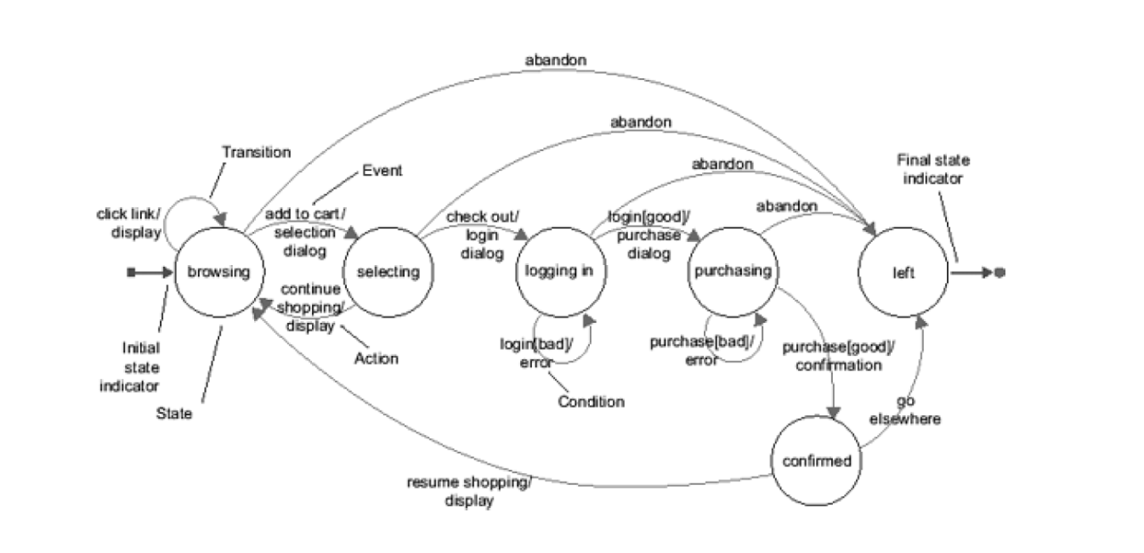
State Transition Diagrams
Demo

Slide 9
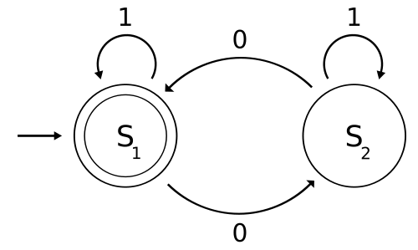
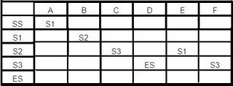
Transition Diagrams and Tables
The underlying model for State-based testing is a state transition diagram or table
The diagram or table connects beginning states, events, and conditions with resulting states and actions

Slide 10

States / Events / Actions
How do we distinguish a state, an event, and an action?
State
Persists until something external happens, usually triggering a transition
A state can persist for an indefinite period

Slide 11
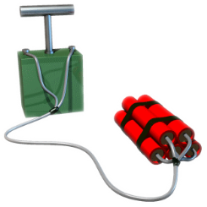
States / Events / Actions (2)
How do we distinguish a state, an event, and an action?
Event
Occurs, either instantly or in a limited, finite period
It is the something that happens
The external occurrence that triggers the transition

Slide 12

States / Events / Actions (3)
How do we distinguish a state, an event, and an action?
Action
The response of the system during the transition
An action, like an event, is either instantaneous or requires a limited, finite period

Slide 13

Coverage Criterions
Various coverage criteria apply for state-based testing:
Visiting every state and traverse every transition
The weakest criterion

Slide 14

Coverage Criterions
Various coverage criteria apply for state-based testing:
At least one test cover every row in a state transition table
High coverage criterion
Achieves "every state and transition" coverage
Covers also combinations not presented in diagrams

Slide 15
Coverage Criterions (2)
Various coverage criteria apply for state-based testing:
At least one test cover each transition sequence of N or less length
The N can be 1, 2, 3, 4, or higher
Also called "N-1 switch coverage"
Coverage depends on the size of N: E.g.: If we cover all transitions of length one and two, then N-1 switch coverage means 1-switch coverage

Slide 16
Customer vs. System Point of View
State transition diagrams can be represented differently according to the point of view:
Customer's point of view
System's point of view
Maintaining a consistent point of view is critical
Otherwise, nonsensical results may occur

Slide 17
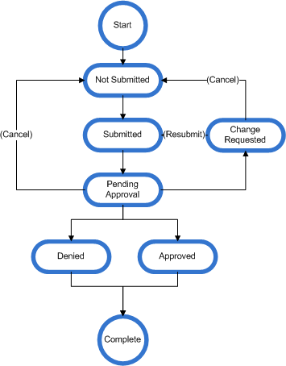

Deriving Test Cases
Procedure for Deriving State-based Tests

Slide 18
Procedure for Deriving Tests
State-based testing provides a formal procedure for deriving tests
Setting a rule for where a test procedure or test step must start and where it may or must end
E.g., a test step may start in an initial state and may only end in a final state
The initial and final states can be the same
Sequences of states and transitions that pass through the initial state more than once can be allowed

Slide 19
Procedure for Deriving Tests
State-based testing provides a formal procedure for deriving tests
Defining a sequence of event/condition combinations that leads to an allowed test ending state
Performed from an allowed test starting state
For each transition that will occur, the expected action that the system should take is captured
Represents the expected result

Slide 20

Procedure for Deriving Tests
State-based testing provides a formal procedure for deriving tests
Each visited state and traversed transition should be marked as covered
The easiest way to do this is by printing the state transition diagram and then using a marker to highlight each node and arrow as you cover it

Slide 21

Procedure for Deriving Tests
State-based testing provides a formal procedure for deriving tests
Steps 2 and 3 should be repeated until all states have been visited and all transitions traversed
I.e. every node and arrow has been marked with the marker

Slide 22
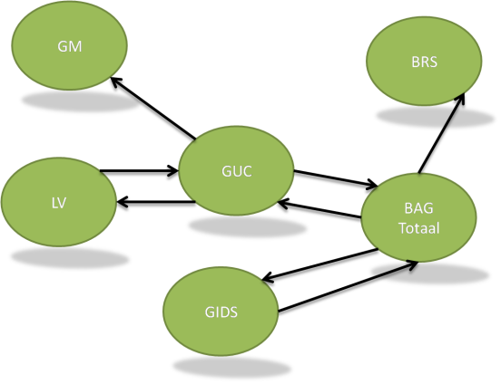
Logical vs. Concrete Tests
The procedure presented before will generate logical test cases
For concrete test cases to be created, actual input values and the actual output values have to be generated

Slide 23

Coverage Completeness Check
When deriving case-based tests a check of coverage completeness achieved have to be done
According to the form used for checking the steps made
Generating tests is not completed until every state and every transition has been highlighted in the check-form

Slide 24
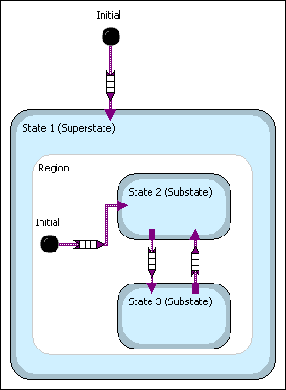
Superstates and Substates

Slide 25
Superstates and Substates
A single state can be unfolded into a superstate consisting of two or more substates
substate
Purchasing
entering address
Specify- ing payment
Editing order
Purchasing
superstate

Slide 26

Superstate Coverage Rule
The rule for basic coverage requires covering:
All transitions into the superstate
All transitions out of the superstate
All substates
All transitions within the superstate

Slide 27
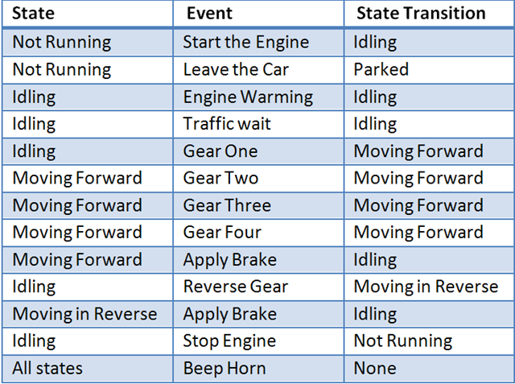
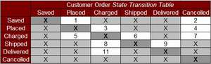
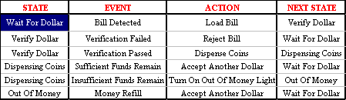
State Transition Tables

Slide 28
Constructing State Transition Tables
Constructing state transition tables follows the scheme:
List all the states from the state transition diagram
List all the event/condition combinations shown on the state transition diagram
Create a table that has a row for each state with every event/condition combination

Slide 29
State Transition Tables - Rows
Each row in a state transition table has four fields:
Current state
Event/condition
Action
New state

Slide 30


Why State Transition Tables?
Why State Transition Tables?
They force us to consider combinations of states with event/condition combinations that we might have forgotten

Slide 31

Discovering Undefined Situations
Deriving state transition tables can reveal undefined situations
Forgotten by the business analysts
Considered to be impossible
The test analyst has the task to find the way a barely possible situation may occur

Slide 32
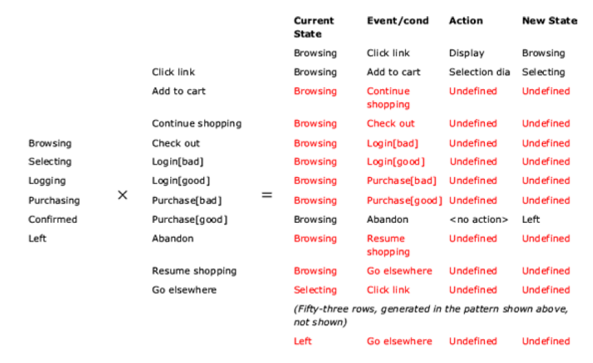
State Transition Tables
Demo

Slide 33

Generating Test Cases From State Transition Tables

Slide 34

Deriving Table-based Tests
Deriving tests covering a state transition table can be based on the following steps:
Start with a set of tests derived from a state transition diagram
Including the starting and stopping state rule
Achieves state/transition covered

Slide 35
Deriving Table-based Tests (2)
Deriving tests covering a state transition table can be based on the following steps:
Construct the state transition table and confirm that the tests cover all the defined rows
If they do not, then there is a problem with the existing set of tests, the table generated or the state transition diagram
Do not proceed until you have identified and resolved the problem

Slide 36
Deriving Table-based Tests (3)
Deriving tests covering a state transition table can be based on the following steps:
Select a test that visits a state for which one or more undefined rows exists in the table
Modify that test to attempt to introduce the undefined event/condition combination for that state
Notice that the action in this case is undefined

Slide 37

Deriving Table-based Tests (4)
Deriving tests covering a state transition table can be based on the following steps:
Mark covered rows
You can use a printed version of the table and a marker for highlighting
Repeat steps 3 and 4 until all rows have been covered

Slide 38

One Undefined Combination per Step
Each test step should include a single undefined event/condition combination
Two undefined actions should not be combined in a single test step
We can't be sure that the system will remain testable after the first invalid

Slide 39
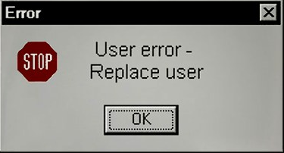
Handling Undefined Conditions
What is the ideal system behavior under undefined conditions?
Undefined event/condition combination should be ignored or rejected with an intelligent error message
Processing continues normally from that point

Slide 40
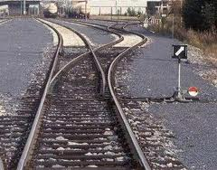
Switch Coverage
Generating Transitions Using the Concept of Switch Coverage

Slide 41

What is Switch Coverage?
Switch Coverage is a technique for generating sequences of transitions
State labels are replaced in the diagram with letters and the transition labels with numbers
A state/transition pair can be specified in a table as a letter followed by a number

Slide 42

Switch Coverage
Demo

Slide 43
Switch Coverage Example
2
4
3
9
10
11
5
1
A
8
B
C
D
E
14
13
12
7
F
6
0-switch |  |  | 1-switch
A1 | A2 | A9 | A1A1 | A1A2 | A1A9

Slide 44
Switch Coverage Example(2)
2
4
3
9
10
11
5
1
A
8
B
C
D
E
14
13
12
7
F
6
0-switch |  |  | 1-switch
A1 | A2 | A9 | A1A1 | A1A2 | A1A9 |  |  |  | A9 B10 | A9B8 | A9B3
B10 | B8 | B3 | B10 C14 | B10 C11 | B10 C4 | B8A1 | B8A2 | B8A9
C14 | C11 | C4 | C14 C14 | C14 C11 | C14 C4 | C11 D13 | C11 D12 | C11 D5
D13 | D12 | D5 | D13 D13 | D13 D12 | D13 D5 | D12 F6 | D12 F7
F6 | F7 |  |  |  |  | F7A1 | F7A2 | F7A9

Slide 45

Combining State Testing with Other Techniques

Slide 46
State Testing with Other Techniques
State-based testing can be well combined with equivalence partitioning and boundary value analysis
EP
pay [good]
American Express
MasterCard
Visa
Invalid (zero)
purchase [bad]
Invalid (too large)
BVA
Invalid (neg.)
Invalid (too low)
Valid
purchase [good]
-max
-0.01
0
0.01
9.99
10
10,000
10,000.01
max

Slide 47
State Transition Testing
?
?
?
?
?
Questions?
?
?
?
?
?
?

Slide 48
Exercises (1)
Given the following state transition diagram – which of the test cases below will cover the following series of state transitions? S1 S0 S1 S2 S0
C, A, B, D
A, B, C, D
D, A, B
A, B, C
A
B
S0
S1
S2
C
D

Slide 49
Exercises (2)
Given the following state transition diagram which of the following series of state transitions contains an INVALID transition which may indicate a fault in the system design?
A
B
D
F
G
Login
Browse
Basket
Check-out
Pay
Log-out
C
E
Login Browse Basket Checkout Basket Checkout Pay Logout
Login Browse Basket Checkout Pay Logout
Login Browse Basket Checkout Basket Logout
Login Browse Basket Browse Basket Checkout Pay Logout

Slide 50
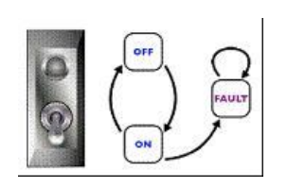
Exercises (4)
Consider the following state transition diagram of a switch. Which of the following represents an invalid state transition?
OFF to ON
ON to OFF
FAULT to ON

Slide 51
Exercises (5)
For the examples on the next slides perform the following:
Draw a state transition diagram
Determine the level of coverage
Make a state transition table from the diagram
Define logical test cases

Slide 52
Exercises (6)
Two-speed electric toothbrush
A two-speed electric toothbrush is operated by pressing its one button
The ﬁrst press of the button turns the toothbrush from off to speed one, the second press of the button turns it to speed two
When the button is pressed for a third time the electric toothbrush is turned off

Slide 53
Exercises (7)
Tape player
A tape player has three operations: play, fast forward and fast play.
Play and fast forward are activated using the play and fast forward button respectively. These operations can be cancelled using the stop button. When in play mode, the fast forward can be used to fast play. When in fast play mode, the fast forward button can be pressed again to enter fast forward or the stop button can be used to return to play. When in fast forward the play button can be pressed to enter play mode directly.

Slide 54
Exercises (8)
Simple electronic clock
A simple electronic clock has four modes: display time, change time, display date and change date
The change mode button switches between display time and display date
The reset button switches from display time to adjust time or display date to adjust date
The set button returns from adjust time to display time or adjust date to display date

Slide 55
Resources
http://istqbexamcertification.com/what-is-state-transition-testing-in-software-testing/
http://www.ruleworks.co.uk/testguide/BS7925-2-Annex-B3.asp

Slide 56




Free Trainings @ Telerik Academy
C# Programming @ Telerik Academy
csharpfundamentals.telerik.com
Telerik Software Academy
academy.telerik.com
Telerik Academy @ Facebook
facebook.com/TelerikAcademy
Telerik Software Academy Forums
forums.academy.telerik.com

